Slide 1
Logic Families

Slide 2
Lecture 26 Tri-state Logic
Lecture delivered by:
Deepak V.

Slide 3
Objectives
At the end of this lecture, student will be able to:
Acquire the knowledge of Tri-state Logic
Describe Buses

Slide 4
Topics
Tri-state Logic
Buses
Bus Master

Slide 5
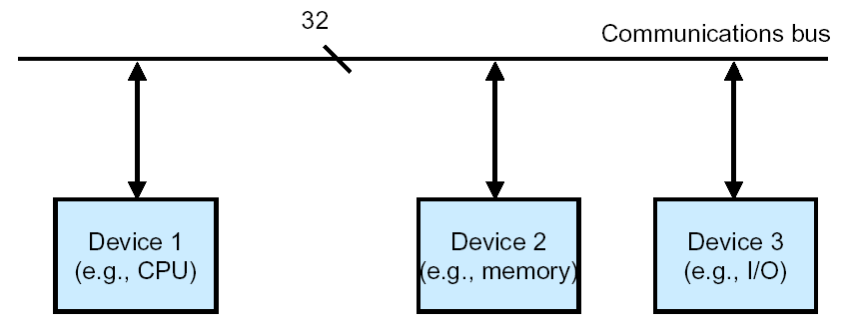
Tri-State Logic
Both output transistors of totem-pole output are turned off
Usually used to bus multiple signals on the same wire
Gates not enabled present high-Z to bus and therefore do not interfere with other gates putting signals on the bus

Slide 6
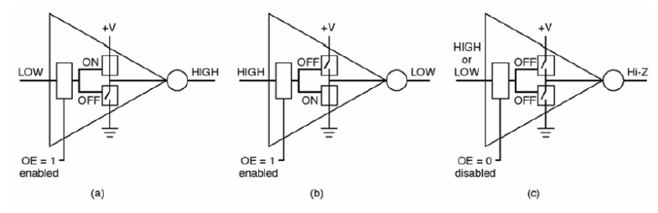
Tri-State Logic
Tri-state logic includes a switch at the output
In the figure below, the three states are illustrated:
Logic High output
Logic Low output
High impedance (Hi-Z) output

Slide 7
Tri-state Logic Outputs
Since the multiple masters on a bus, it needs Tri-state logic for attachment to a bus so that each device can choose to drive or not drive the bus depending on whether it is the bus master for a given bus cycle
Tri-state logic prevents a bus conflict where one device is driving a signal to 1 and another device is driving it to 0 at the same time - generates high current through wires

Slide 8
Tri-State Logic and Buses
The logical element has output enable pin to go from a floating output to drive the output from the circuit
Inverters and buffers are used as bus drivers or buffers
Two such drivers or buffers in opposite directions are used to make the connection bi-directional
The gates also provide more “drive” onto the bus so that the bus signals are stronger and the bus can be longer
enable_{in}
Device
Bus
enable_{out}
Tri-State Logic and Buses

Slide 9
Tri-State Logic
The problem with connecting multiple “normal” outputs together on a bus is that each has to be in one logic state (0) or the other (1) - driving voltage on each bus signal high or low
This represents a conflict over the state of the signal
We resolve this conflict with tri-state logic
Logically
Electrically
Truth Table
A
A
+5v
enable A Output
0 0 (Z)
0 1 (Z)
1 0 1
1 1 0
enable
output
0v

Slide 10
Buses
Concept is to link together multiple functional units over a common data highway at a lower cost than using multiple point to point links
E
E
A
A
OR
Bus
D
D
B
B
C
C
Number of Links = n * (n – 1) / 2

Slide 11
Bus - Essential Part of Any Computer
CPU
Primary
Memory
Secondary
Memory
I/O
Data
Address
Control
Bus

Slide 12
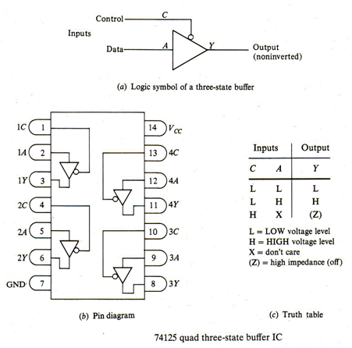
Tri-State Logic and Buses

Slide 13
Bus Master – Slave Relationships
Up till now, It is seen that the address bus and the control bus are always driven by the processor, however that is NOT really true!
That was only a “lie of simplification”
The processor is NOT the only device that may be driving the address and control busses

Slide 14
Bus Arbitration
Bus arbitration is used to hand off a bus between one of several potential bus masters using signals that are a part of the bus itself
A bus arbitration protocol implements some form of bus request and bus grant handshake to determine which device will be the master on the bus for the next bus cycle

Slide 15
Summary
All devices have tri-state logic connections to the data bus – may be driving or receiving
Memory and I/O devices don’t need tri-state logic on address/control bus (never drive them)
Because the processor may need to yield the control/address busses, it must have tri-state logic for driving those bus signals
DMAC controller must have tri-state logic for driving the control and address bus signals

